Slide 1


Attention Mechanism and Transformers
Video 1: Introduction to seq2seq Models

Slide 2
In Air

Slide 3
Types of RNN
Many to One
Many to Many
Many to Many
One to Many
One to One
Output at each time step
Hidden Layers
Vectorized Input

Slide 4
Types of RNN
Many to One
Many to Many
Many to Many
One to Many
One to One
Output at each time step
Hidden Layers
Vectorized Input

Slide 5

Input & Output : Sequential Data
Many to One
Machine Translation
Question Answering Code Generation Text Summarisation

Slide 6
Many to Many RNN
Many to Many
Many to Many
Language translation
NER
Summary generation
POS Tagging
Question & Answering
Text Generation
Seq2Seq model

Slide 7
Many to Many RNN
Many to Many
Output
Encoder state
ENCODER
DECODER
Input

Slide 8
Encoder-Decoder Models
Output
Encoder state
ENCODER
DECODER
Input

Slide 9
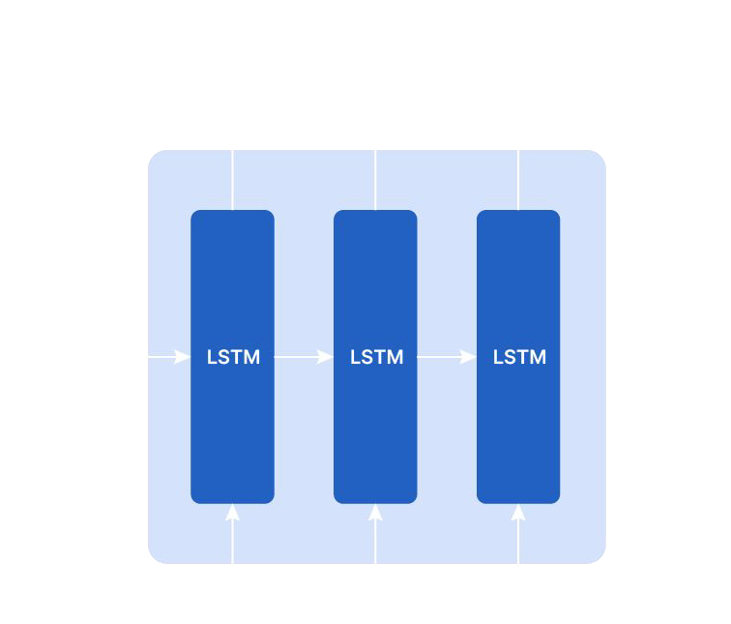
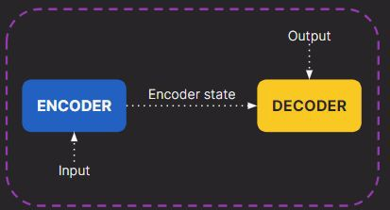
Encoder
Discards the output at every step and preserves only the encoder state.
E_{s}
Input Sequence

Slide 10

Encoder State
Encapsulates the full meaning of the input sequence
Encoder State
Guides decoder in making accurate output predictions.

Slide 11
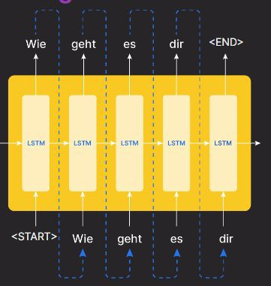
Decoder
E_{s}
Utilizes encoder state for Sequential Token Prediction

Slide 12
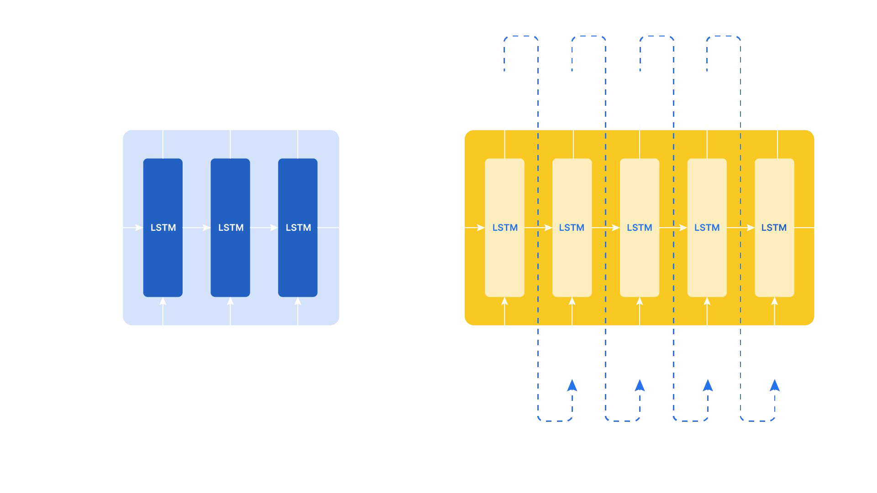
Encoder-Decoder Model
<END>
E_{s}
<START>

Slide 13
Encoder-Decoder Model
Translate English to German:
"How are you?"
"Wie geht es dir?"

Slide 14
Working of Encoder-Decoder Model
E_{s}

Slide 15
Working of Encoder-Decoder Model
Timestep 1 : Initialization of Decoding
3 inputs -
E_{s}
Context vector, h
Cell state, c₃
<START> token
3
<START>
Decoder combines context vector ℎ3, cell state c3, and <START> token to predict initial output word “wie”.

Slide 16
Working of Encoder-Decoder Model
Timestep 2, t=2 in Decoding Process
3 inputs -
E_{s}
Previous hidden state
Previous cell state
Previous output “wei” as
the current input
<START>
Uses previous hidden state, cell state, and output “wei” to predict next word “geht”.

Slide 17
Working of Encoder-Decoder Model
Continuation and Termination of Decoding
<END>
E_{s}
<START>
Each time step’s output is fed into the next until the “<END>” symbol indicates sequence end; final states discarded

Slide 18

"<START>" and "<END>" can be replaced with any unique strings like “<SOS>” AND “<EOS>”.
Ensure symbols are not present in the data corpus to prevent model confusion

Slide 19

Differences in training and testing phases

